Slide 1
ATMPG
A proposed approach
For Strategy development
GC

Slide 2
This is 3rd draft , presenting sequence of maps as discussed within the ATM Group to provide basis of analysis , presentation and conclusion
Introduction

Slide 3
Initial list : Parking Speeding Traffic traversing the town Narrow Roads Buses, size / capacity , routes and timetabling Pedestrians, lack of pavements and size and quality of pavements Age profile of residents Size and number of cars Lack of electric charging points One-way systems Impact of new developments School Runs Additional considerations / topics : Additionally : Danger spots … Business owners … Leisure walkers / trail walking ; different to pedestrians
Reviewed Consideration's

Slide 4
Focus is the Market Square Secondary Focus is within the Conservation Area
Introduction

Slide 5
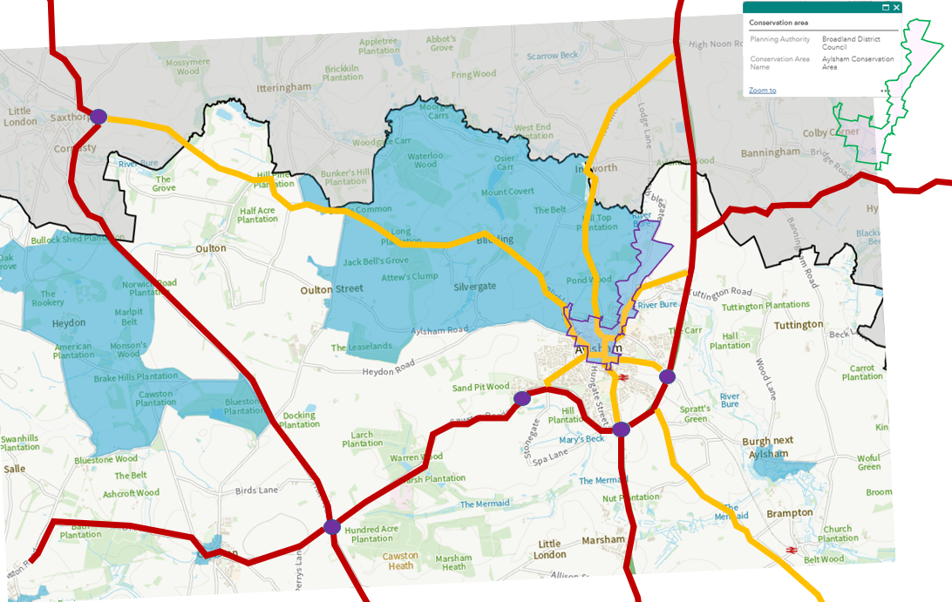
Strategic
Map
Provides wider view of current and potential future transport links

Slide 6
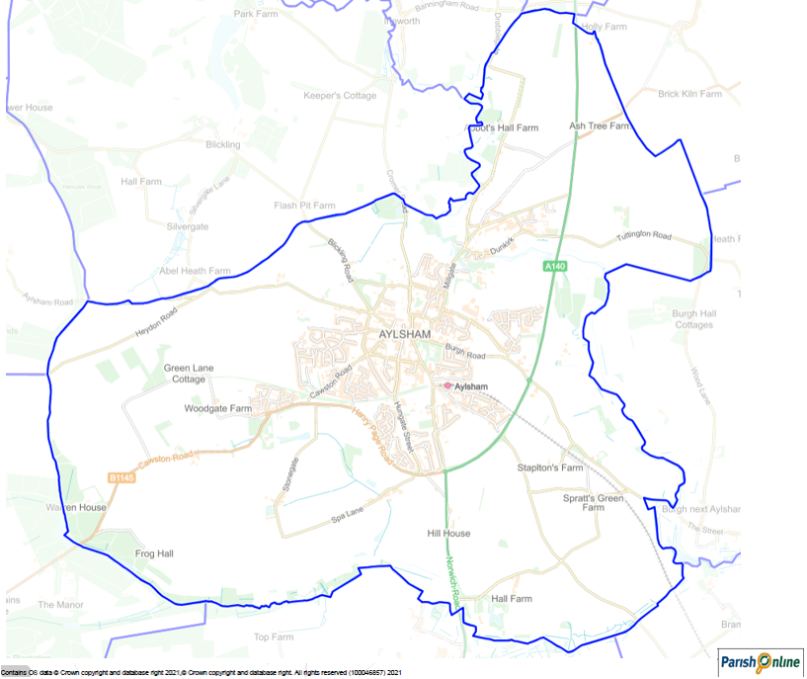
Parish
Map

Slide 7
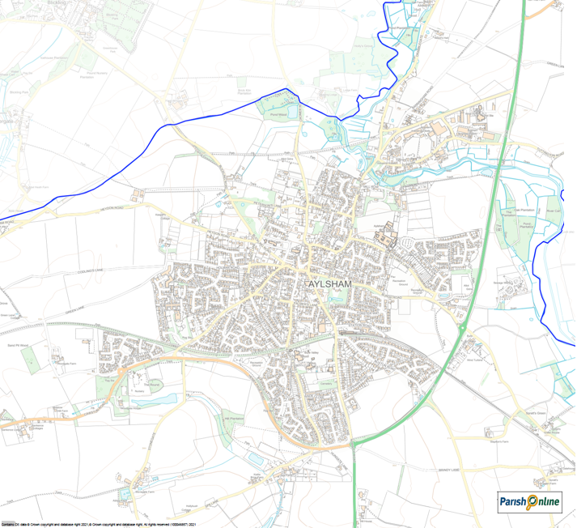
Aylsham Town
Map

Slide 8
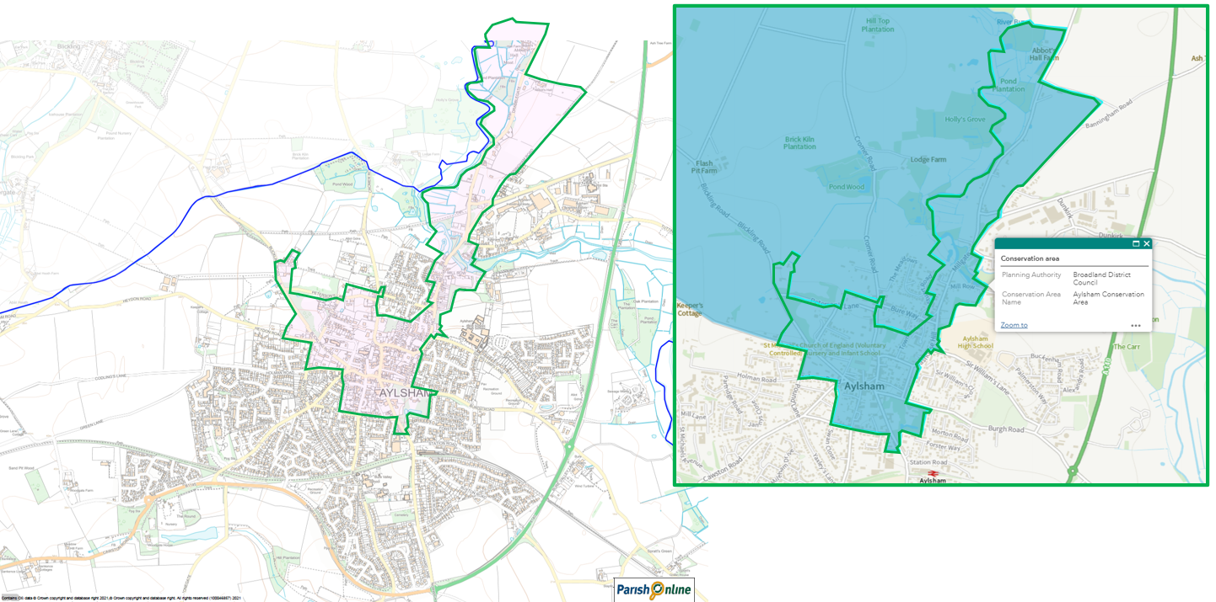
Conservation Area - Map

Slide 9
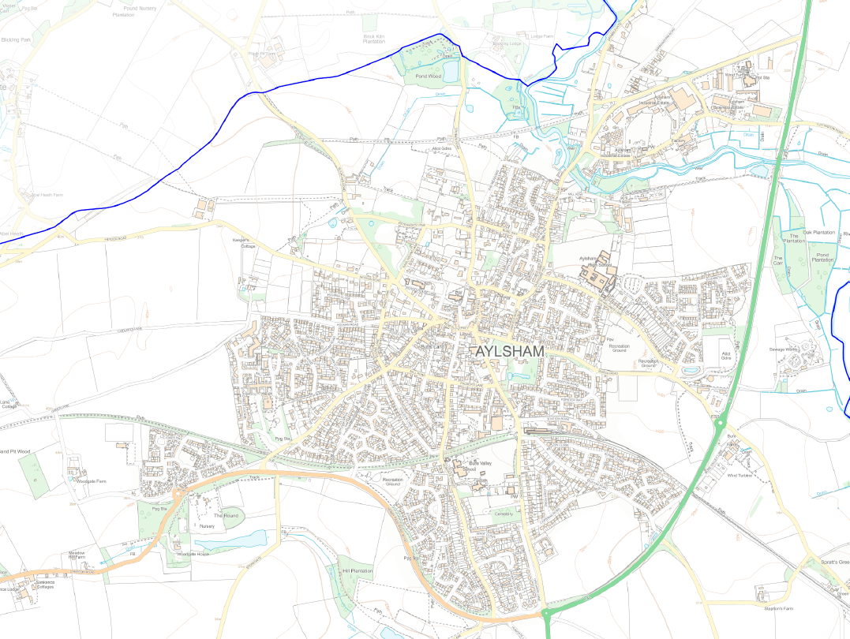
ATMPG
Map 1
Focus Area
OS Map extract of Aylsham and immediate area , within 1.6 km of the centre
Conservation Area
Market Square

Slide 10
ATMPG
General Layout
Initial visual assessment of routes
1st Draft
Main Roads : 2-way
- Norwich > Cromer
- Secondary routes : Cawston / Buxton / North Walsham / Corpusty
- Town Roads
- Restricted / single

Slide 11
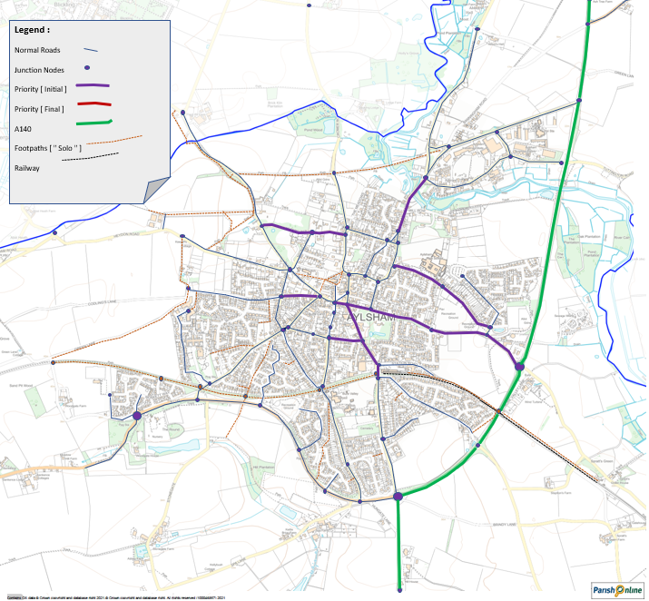
Detailed Street Map
Development from 1st Draft , to provide specific location references
Street Identifier
Coordinates with ‘ Street Schedule ‘ , to provide basis of analysis and presentation
Priority Roads were identified at ATMG Meeting # 3

Slide 12
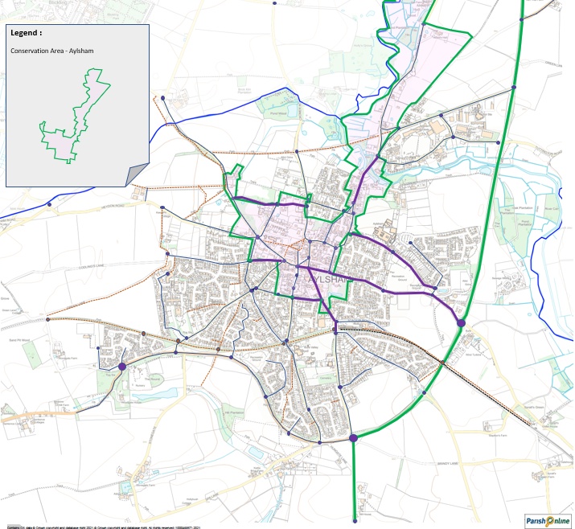
Detailed Street Map
with
Conservation Area
Street Identifier – presented as 1st Draft , for Group review and development
Coordinates with ‘ Street Schedule ‘ , to provide basis of analysis and presentation
Street Schedule is presented in a separate Workbook , so that ease of comparison / compilation can be made on split-screen / 2 screens
Priority Roads were identified at ATMG Meeting # 3

Slide 13
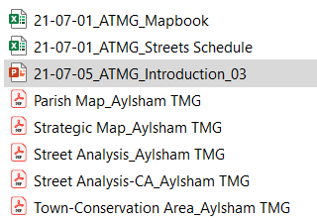
References

Slide 14
Review

